Slide 1
Internet Ecosystem in Nepal
By Shreedeep Rayamajhi
Presentation for Nepal School of Internet Governance 2018
19-20 January 2018

Slide 2
What is internet ?
Networks of Network
The Internet is the global system of interconnected computer networks that use the Internet protocol suite (TCP/IP) to link devices worldwide.
What is the Internet Penetration of Nepal ?

Slide 3
What is internet Ecosystem?
Source: World Stat
The “Internet Ecosystem” is a term used to describe the organizations and communities
that help the Internet work and evolve.

Slide 4
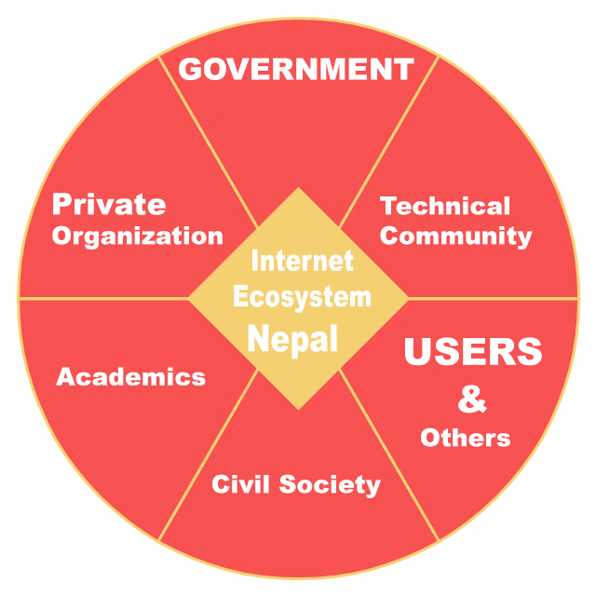
Nepal Internet Ecosystem

Slide 5
What is multistakeholderism?
Multistakeholderism is the process of managing the various stakeholder in the Internet ecosystem adapting values of standardization, diversity and equality to bring people together in discussions on public policy issues.
Values of Multistakeholderism -Openness -Transparency -Accountability -Diversity -Equality

Slide 6
Role Play on Internet challenges of Nepal
Benefits:
Role plays helps to create better understanding of how the Internet ecosystem works
Helps to highlights issues, problems and challenges
Highlights key objective of multistakeholderism
Rules : 1. Each table will have a definite stakeholder tag where the participants have to represent that stakeholder and deal with the challenges
2. Each table will have a person dedicated who will take the note of the Discussion
3. The table has to list top 5 key challenges as a Team 4. The Decision process will be done openly

Slide 7
What do you think are the major challenges of Internet in Nepal from different stakeholder perspective ?

Slide 8
Thank you

